Slide 1
Object Detection Using ConvNets

Slide 2

Follow up Contents
Classical Computer vision
Image matching problem
Corner Detection
SIFT
HOG
Object Classification + localization and Detection Using Classical CV
Dalal and Trigs: HOG + SVM
DPM
CNN based Ideas for Object detection

Slide 3
Follow up Contents
CNN based Ideas for Object detection
Over feat network
Selective search
Edge boxes
RCNN
Special pyramid network
Fast RCNN
Faster RCNN
YOLO
SSD
CNN + Classical Based Region Proposal Paradigm
CNN Based
Single Shot Paradigm

Slide 4
Prerequisite
Understanding CNN
Back propagation
Strides , Filters and Max pool, SoftMax etc.
Transfer Learning
Butterfly Learning

Slide 5

Convolution Neural Network Intuition
HOG Feature
Classification
MODEL
SVM
Classify
Cat or Not
Cat
3780 x 1
Single Object
Feature Extraction
Classification
Classical CV

Slide 6
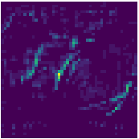
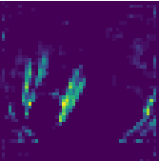
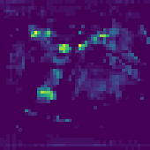
Convolution Neural Network Intuition
CNN Feature
Classification
MODEL
SOFTMAX
Classify
Cat or Not
Cat
Single Object
Feature Extraction
Classification
CNN

Slide 7
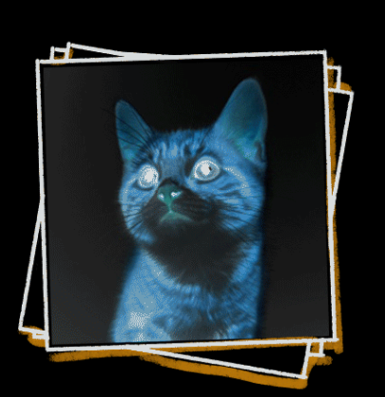
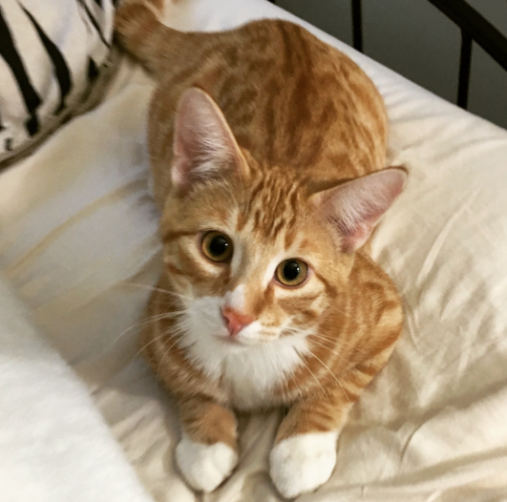
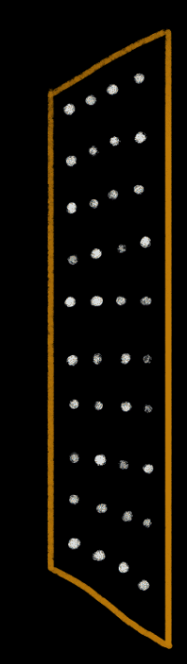
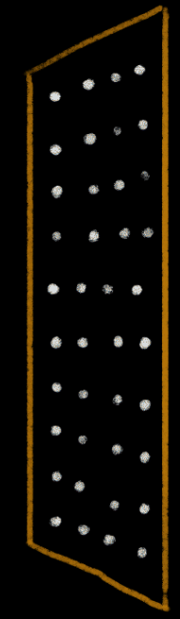
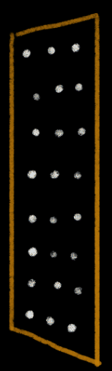

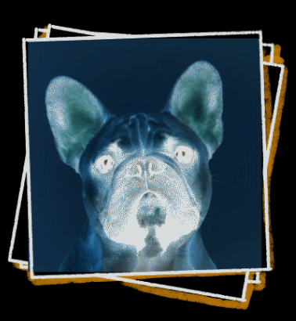
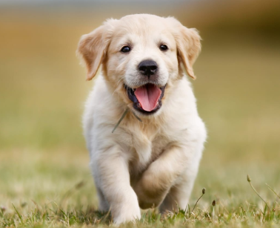
Classification: Training
SOFTMAX
Minimize LOSS
Classification
Feature Extraction
Input
CNN Architecture
Butterfly Learning

Slide 8
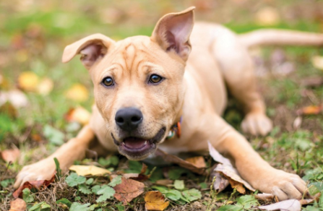

Classification: Prediction
SOFTMAX
Classification
Feature Extraction
Query Input
CNN Architecture

Slide 9
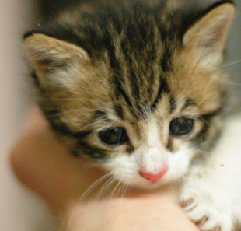

Classification: Prediction
SOFTMAX
Classification
Feature Extraction
Query Input
CNN Architecture

Slide 10
Convolution Neural Network Intuition
Difference Between Classical CV and CNN
Classical CV
CNN
Hard Coded filters for feature extraction
Require the domain knowledge to craft new filters
Filters are trained using convolutions
Automatically learns the general property of input data
Does that mean we cannot extract the feature in CNN as same way as classical CV ?

Slide 11
Convolution Neural Network Intuition – Transfer Learning
CNN Feature
Classification
FC1
FC2
MODEL
SOFTMAX
Output
Alex Net / VGG
Cat
Single Object
Feature Extraction
Classification
Keep the weights of pretrained model fix.
Only train classification layer.

Slide 12
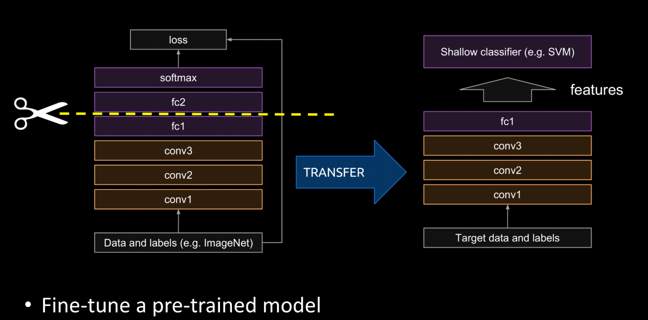
Convolution Neural Network Intuition – Transfer Learning
Credit: https://www.youtube.com/watch?v=O5xeyoRL95U&ab_channel=LexFridman

Slide 13

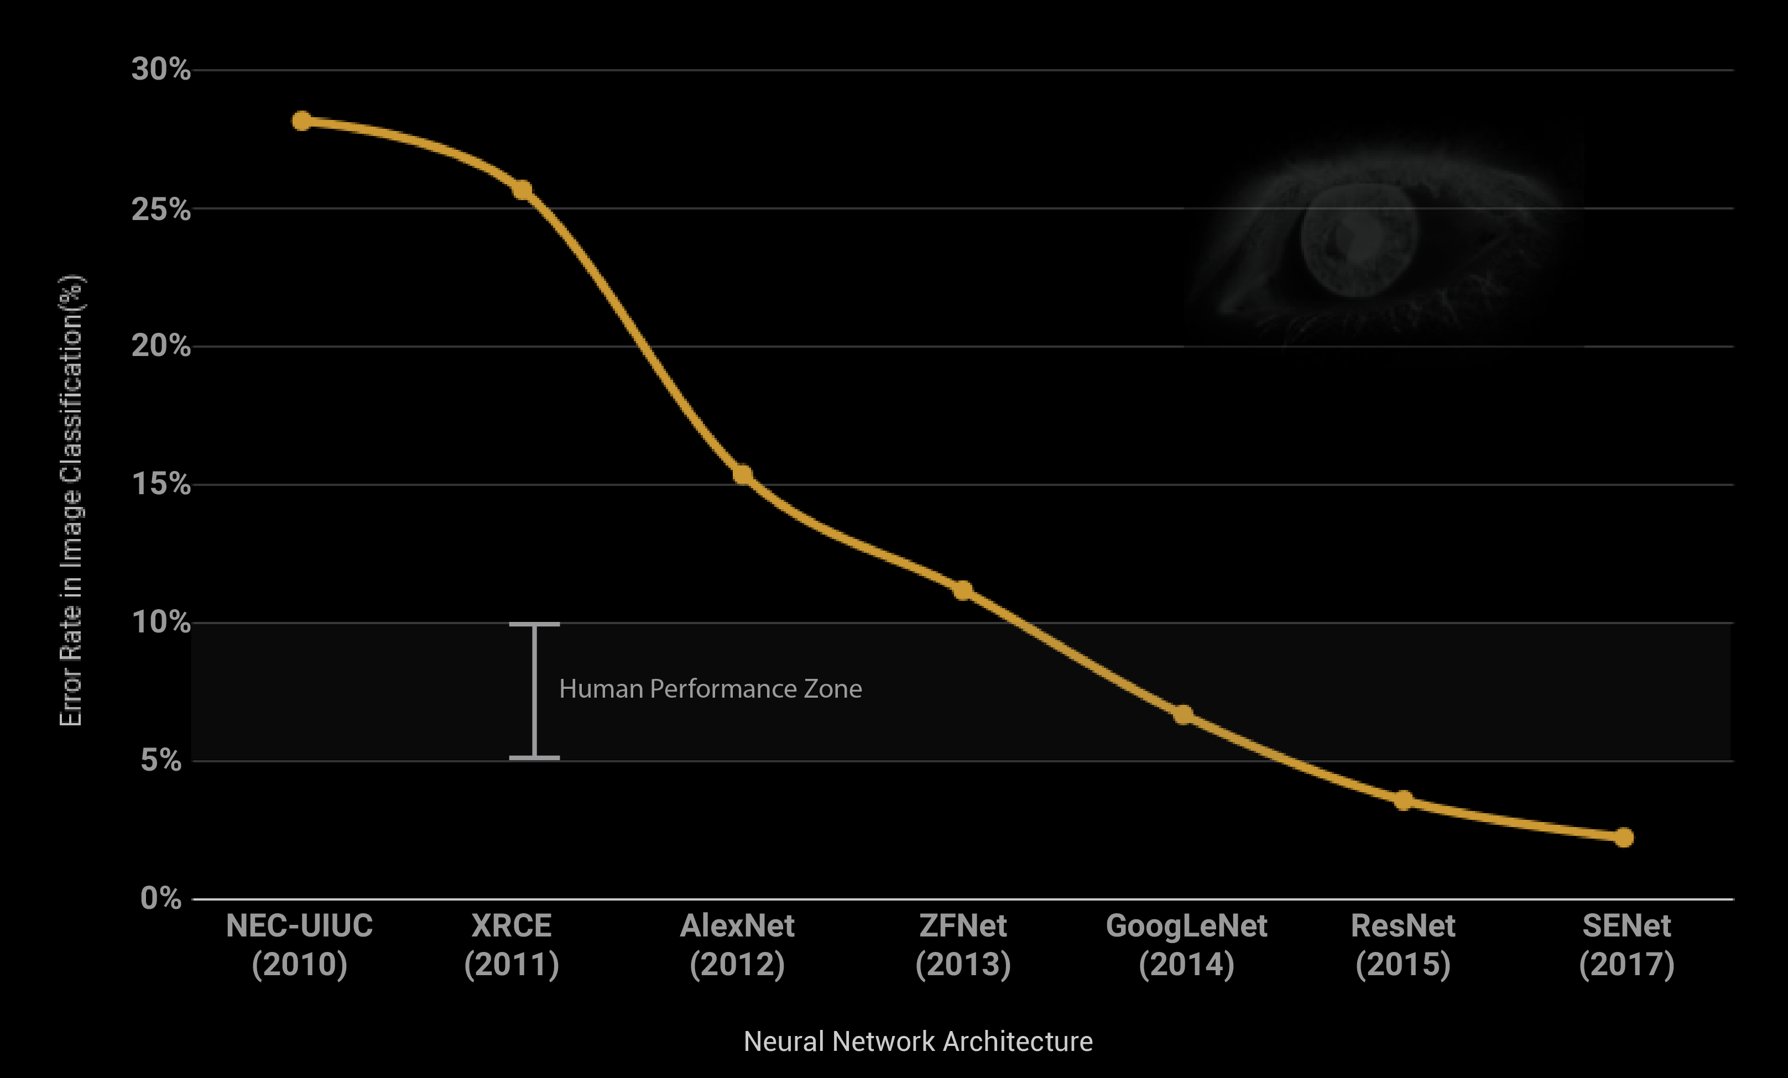
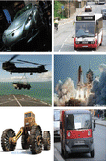
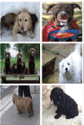
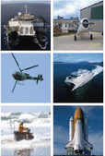
Convolution Neural Network Intuition
Classical CV
CNN
Vehicle
Dog
Craft
Image Credit: https://mesin-belajar.blogspot.com/2017/08/must-read-path-breaking-papers-about.html

Slide 14
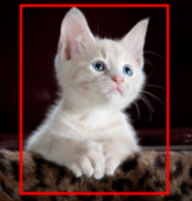


Object Localization using Convolution Neural Network
Classical CV approach
bx
by
bh
bw
Localize Bounding Box of single object
Classification and Localization
MODEL
Cat + Bounding Box
Classify
Cat or Not
Feature Extraction
Single Object + Localized
Sliding Window
Image Pyramid
Image Pyramid

Slide 15
Object Localization using Convolution Neural Network
Classical CV approach
Sliding Window – For Localizing Bbox
Image Pyramid – For different size of object
Problem with Classical CV approach
No training is happening for feature extraction
Classification layer is very simple
Only hardcoded feature transforms are used which require domain knowledge
Fixed aspect ratio Bbox for all detection

Slide 16
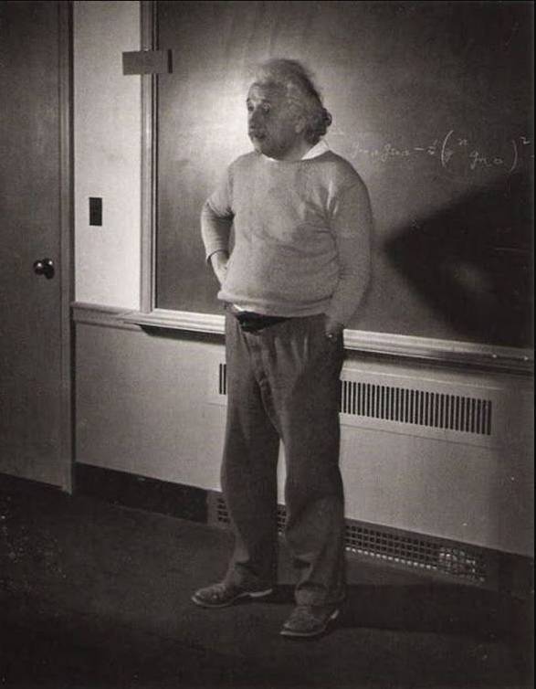
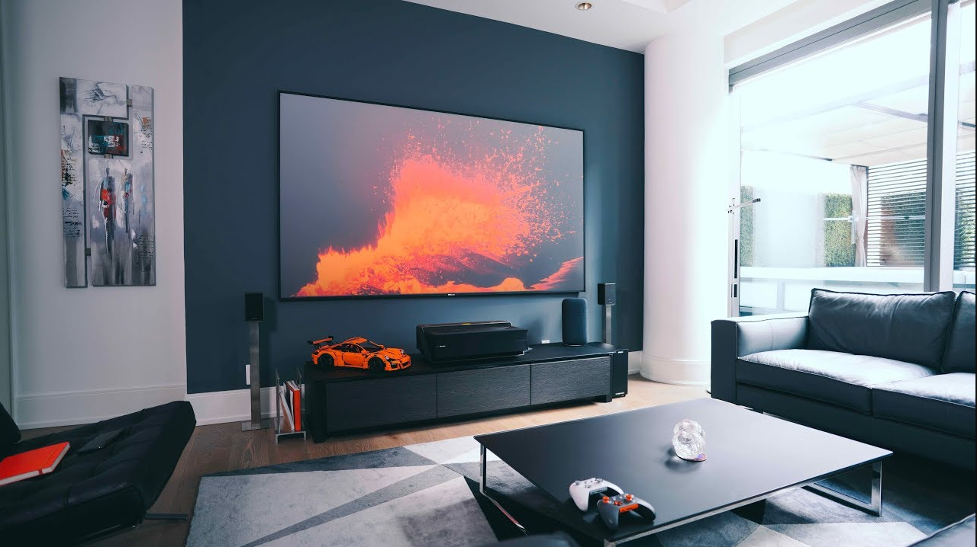
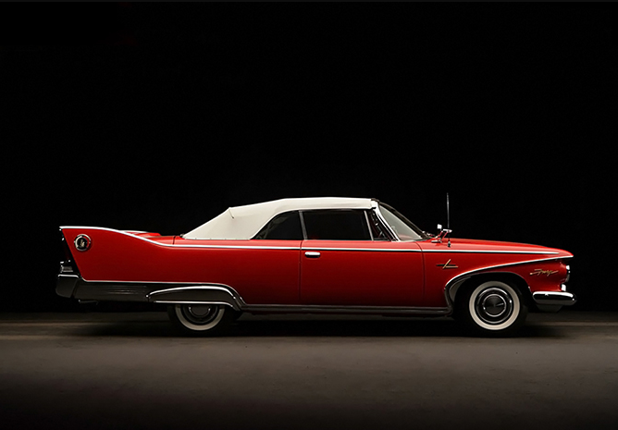
Object Localization using Convolution Neural Network
Problem with Classical CV approach
Fixed aspect ratio Bbox for all detection
Sliding Window – For Localizing Bbox
Person
.
TV
.
.
Car
.
.
.
.
Sliding Window Size – Typically 1:1

Slide 17
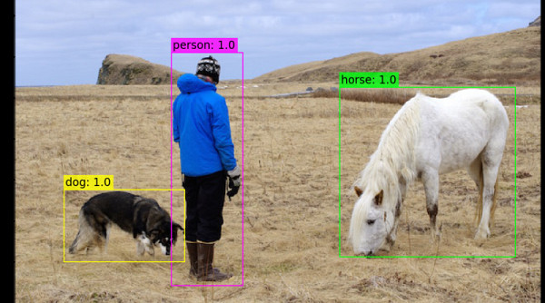
Object Localization using Convolution Neural Network
Problem with Classical CV approach
Fixed aspect ratio Bbox for all detection
Sliding Window – For Localizing Bbox
.
.
.
.
.
.
.
Sliding Window Size – Typically 1:1

Slide 18
Object Localization using Convolution Neural Network
Classical CV approach
bx
by
bh
bw
Localize Bounding Box of single object
Classification and Localization
MODEL
Cat + Bounding Box
Classify
Cat or Not
Feature Extraction
Single Object + Localized

Slide 19
Object Localization using Convolution Neural Network
Localize Bounding Box
b_{x} b_{y} b_{h} b_{w}
CNN approach
Class 1
Class 2
Classification and Localization
FC1
FC2
Class k
MODEL
Regression
Class 1
Class 2
Feature Extraction
SOFTMAX
Cat + Bounding Box
Single Object + Localized
Classify
Cat or Not
Classification
Class k

Slide 20
Object Localization using Convolution Neural Network
Localize Bounding Box
b_{x} b_{y} b_{h} b_{w}
CNN approach
Class 1
Person
Class 2
Dog
FC1
Cat
Class k
Car
FC2
Regression
0.2
Class 1
Person
_
Class 2
Dog
SOFTMAX
_
_
0.7
Cat
_
_
Classify
Cat or Not
Classification
0.1
Class k
Car

Slide 21
Object Localization using Convolution Neural Network
Localize Bounding Box
b_{x} b_{y} b_{h} b_{w}
CNN approach
Class 1
Person
Class 2
Dog
Classification and Localization
FC1
Cat
Class k
Car
FC2
Regression
0.2
Class 1
Person
_
Class 2
Dog
SOFTMAX
_
Cat + Bounding Box
_
0.8
Cat
_
_
Classify
Cat or Not
Classification
0.1
Class k
Car

Slide 22
Object Localization using Convolution Neural Network
Localize Bounding Box
b_{x} b_{y} b_{h} b_{w}
Person
0.1
0.2
^{Person}
^{cat}
Dog
0.8
FC1
Cat
FC2
Car
Regression
Class 1
Person
Class
Conf.
b_{x} b_{y} b_{h} b_{w}
0.2
_
Class 2
Dog
Person | 0.1 | 0.3 | 0.7 | 0.3 | 0.2
Car | 0.7 | 0.5 | 0.4 | 0.3 | 0.8
Cat | 0.2 | 0.8 | 0.8 | 0.2 | 0.2
SOFTMAX
_
_
0.7
Cat
_
_
Classify
Cat or Not
Classification
0.1
Class k
Car

Slide 23
Object Localization using Convolution Neural Network
How does Regression learn to localize Bbox ? – Training of Regression network
0 , 0
.
Localize Bounding Box
L₂ Loss minimization
Car
b_{x} b_{y} b_{h} b_{w}
Class 1
Class 2
1 , 1
b_{x} b_{y} b_{h} b_{w}
L₂ Loss
Actual Bbox
0.5 | 0.4 | 0.3 | 0.8
b_{x} -b_{x}’
b_{y} -b_{y}’
b_{h} -b_{h}’
b_{w} -b_{w}’
Total Loss
Class k
Regression
Predicted Bbox
0.0 | 0.0 | 1.0 | 1.0
0.5 | 0.5 | 0.8 | 0.8
0.6 | 0.4 | 0.4 | 0.7
0.5 | 0.4 | 0.3 | 0.8
0.25 | 0.16 | 0.49 | 0.04
0.0 | 0.01 | 0.25 | 0.0
0.01 | 0.0 | 0.01 | 0.01
0.0 | 0.0 | 0.0 | 0.0
Iter 1
0.94
0.26
0.03
0.0
Iter 10
Iter 100
Iter 500

Slide 24
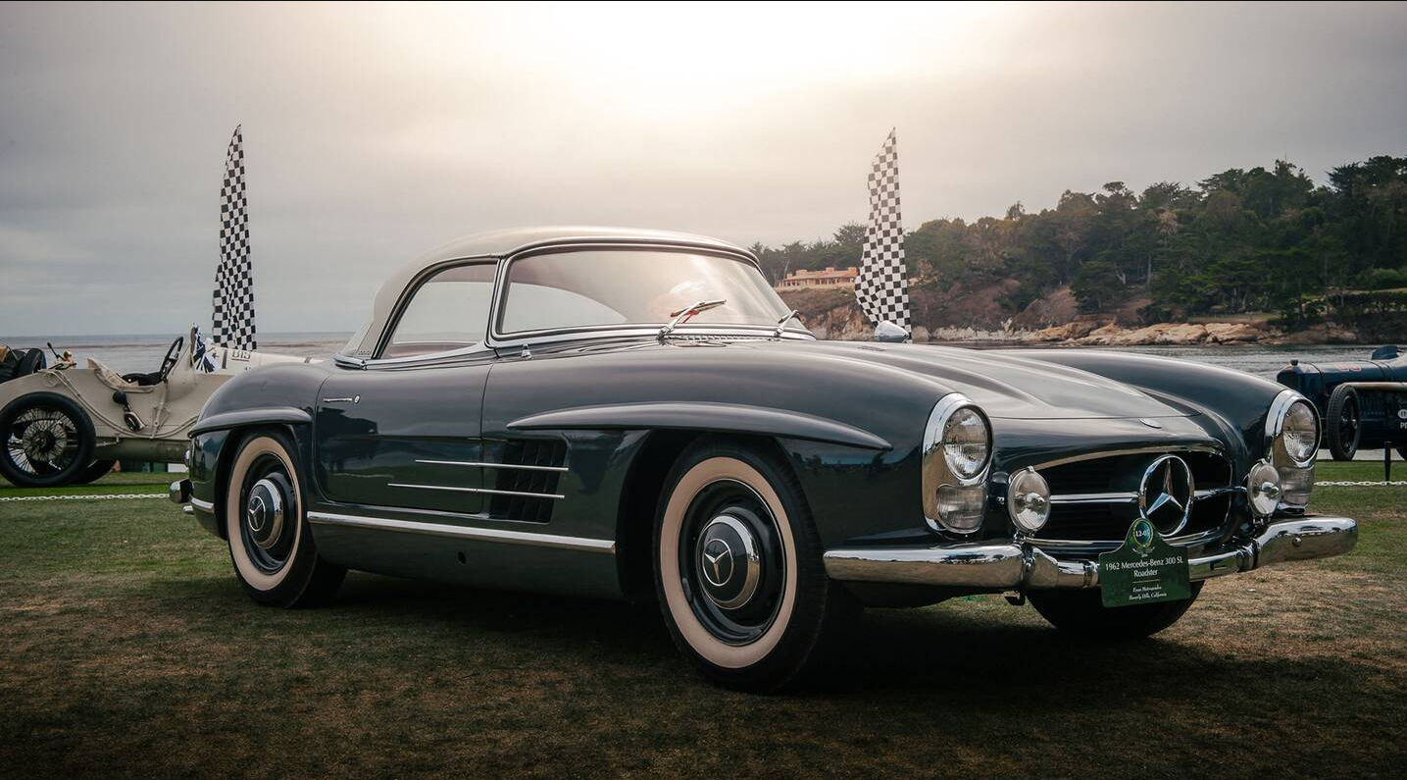
Object Localization using Convolution Neural Network
CNN Learns the generic property of each objects
Person
.
.
Car Example 1
Person Example
.
Car Example 2
.
.
.

Slide 25
Object Detection using Convolution Neural Network

Slide 26
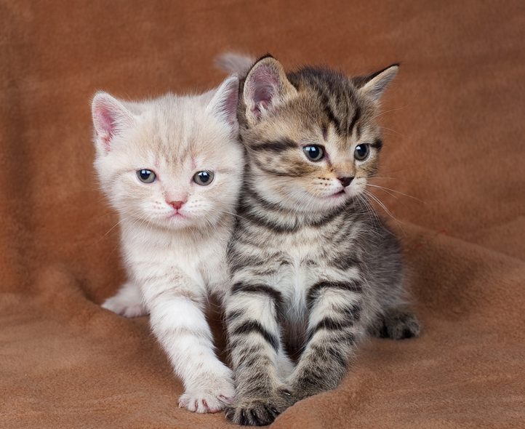
Object Detection using Convolution Neural Network
Idea 1
Pretrained Model
Testing
FC1
Regression
MODEL
FC2
VGG 16
Query Input
Feature Extraction
Classification
Pre Trained Localize Model
Crops + Resize

Slide 27
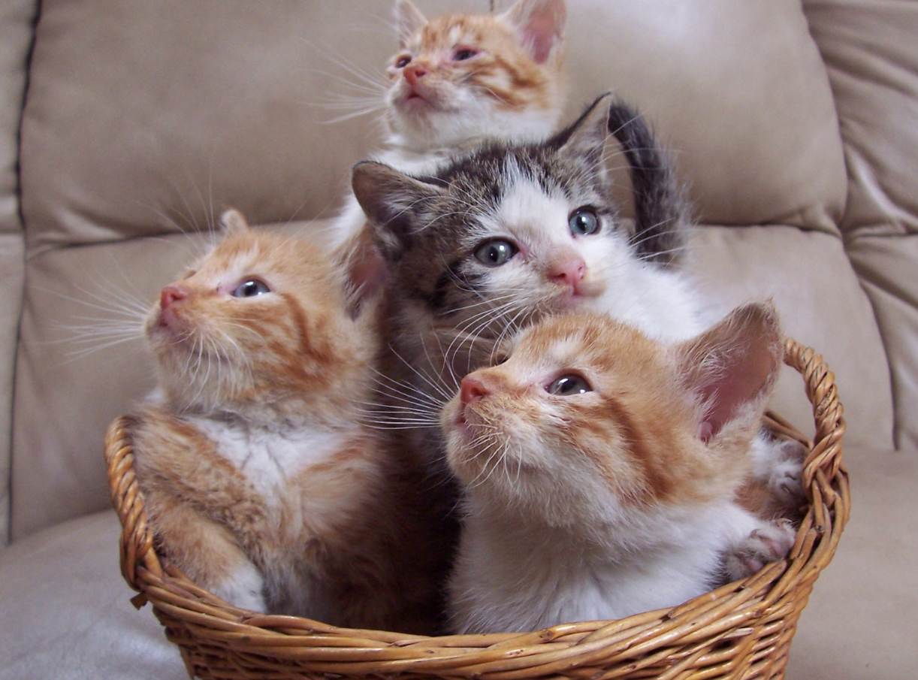
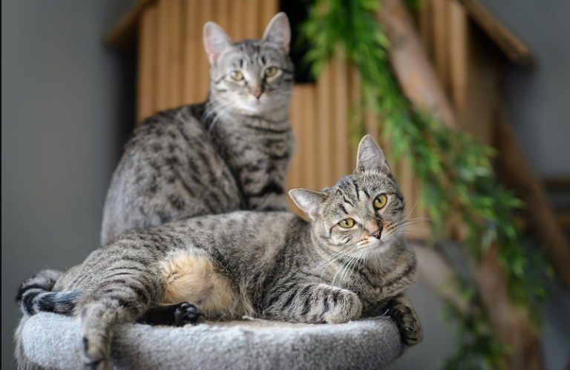

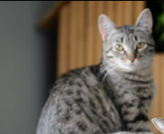
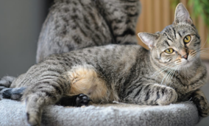
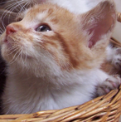


Object Detection using Convolution Neural Network
Pretrained Model
Testing
Crops
Crops

Slide 28
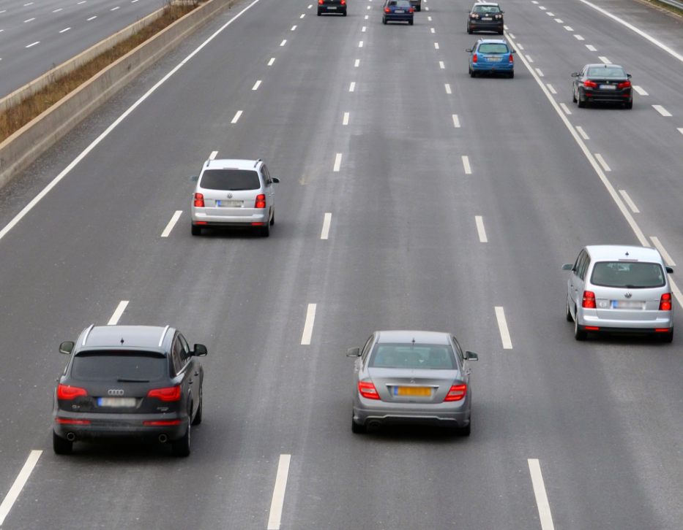
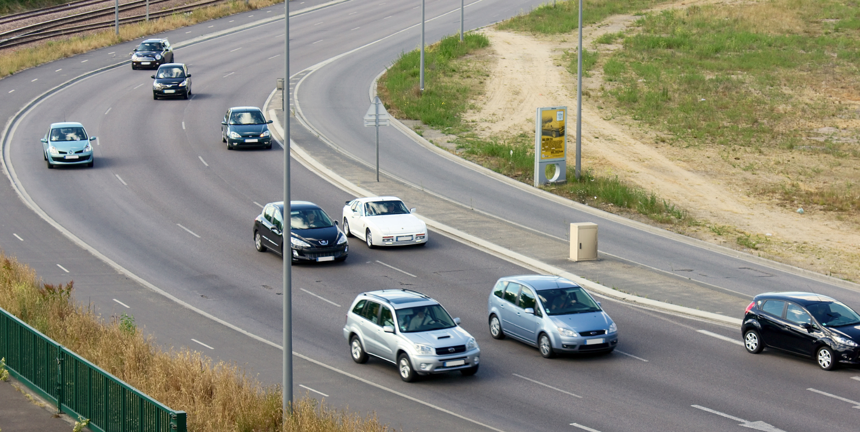
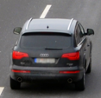
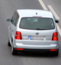


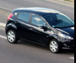


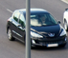

Object Detection using Convolution Neural Network
Pretrained Model
Testing

Slide 29
Object Detection using Convolution Neural Network
Idea 2
Sliding window crops + Pretrained Model
Testing
Query Input

Slide 30


Object Detection using Convolution Neural Network
Idea 2
Sliding window crops + Pretrained Model
Testing
FC1
Regression
MODEL
FC2
VGG 16
Feature Extraction
Classification
Query Input
Crops
Pre Trained Localize Model
How to detect multiple size image?
Image size could be of different size. How to tackle CNN constrain?
we still have problem of feeding one crop at a time to model.
Is there any way to make it End to End ?

Slide 31
Object Detection using Convolution Neural Network
Idea 3
Sliding window crops + Pretrained Model + Image Pyramid
Testing
How to detect multiple size image?
FC1
Regression
MODEL
FC2
VGG 16
Sliding window
+
Image Pyramid
Feature Extraction
Classification
Pre Trained Localize Model
Image size could be of different size. How to tackle CNN constrain?
we still have problem of feeding one crop at a time to model.
Is there any way to make it End to End ?

Slide 32
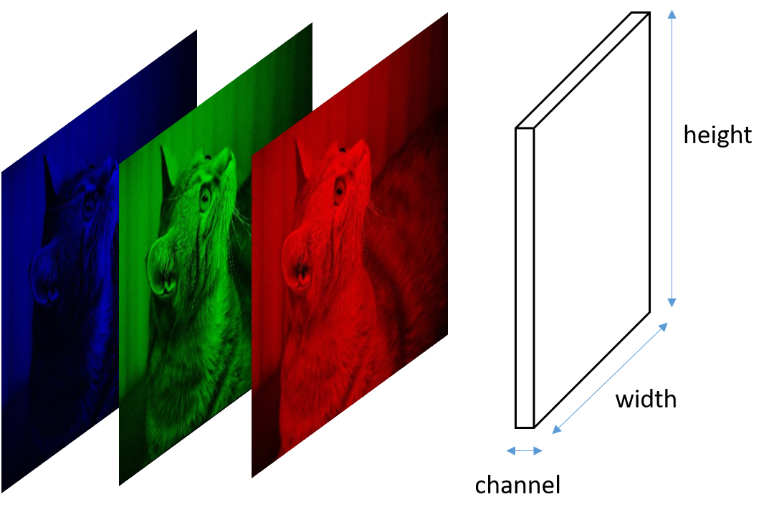
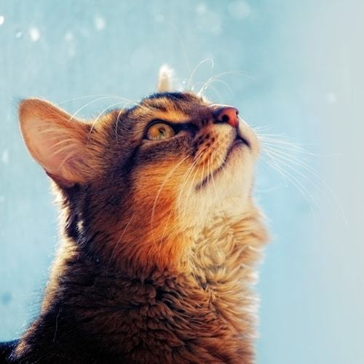
Object Detection using Convolution Neural Network
Constrain of CNN
What is the CNN constrain?
Calculation of input and output shape of a convolution network
Output when image and filter are square
n x n x c input size
K x k x c filter size
padding of p
Strides of s
m
12
x
5 x 5 x 3
n – k + 2p + 1
O =
s
k x k x c
32 x 32 x 3
28 x 28 x 12
Output when image and filter are non square
n x n x c
(n – k) x (n - k)
x m
n_{h} x n_{w} x c input size
K_{h} x k_{w} x c filter size
padding of p
Strides of s
n_{h} – k_{h} + 2p
n_{w} – k_{w} + 2p
O_{h} =
s
+ 1
O_{w} =
+ 1
s

Slide 33

Object Detection using Convolution Neural Network
Constrain of CNN
What is the CNN constrain?
2352
SOFTMAX
FC1
12
x
MAX Pool
Resize
5 x 5 x 3
2 x 2
32 x 32 x 3
28 x 28 x 12
14 x 14 x 12
2352
2352
8 Class
2352
SOFTMAX
FC1
12
x
MAX Pool
Resize
5 x 5 x 3
2 x 2
34 x 34 x 3
30 x 30 x 12
15 x 15 x 12
2352
2352
8 Class

Slide 34
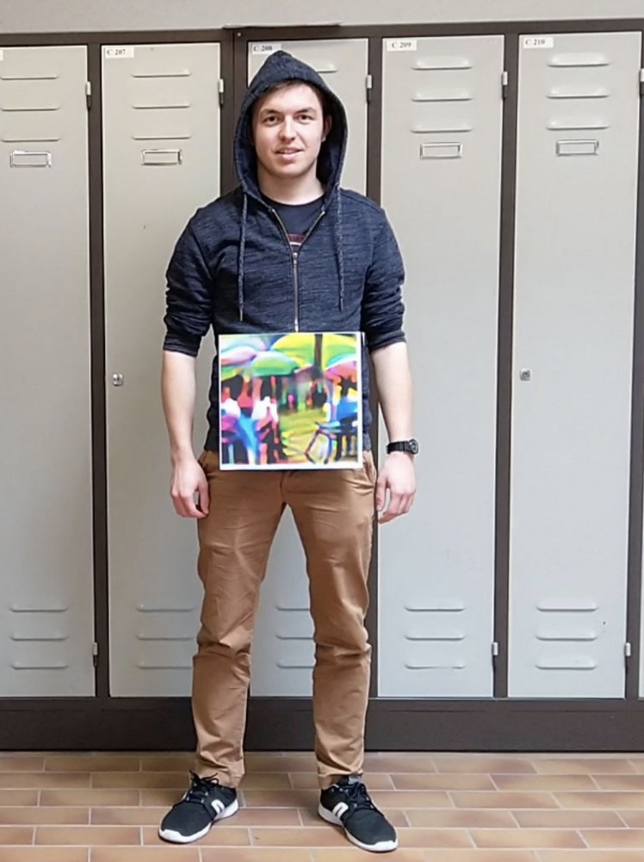
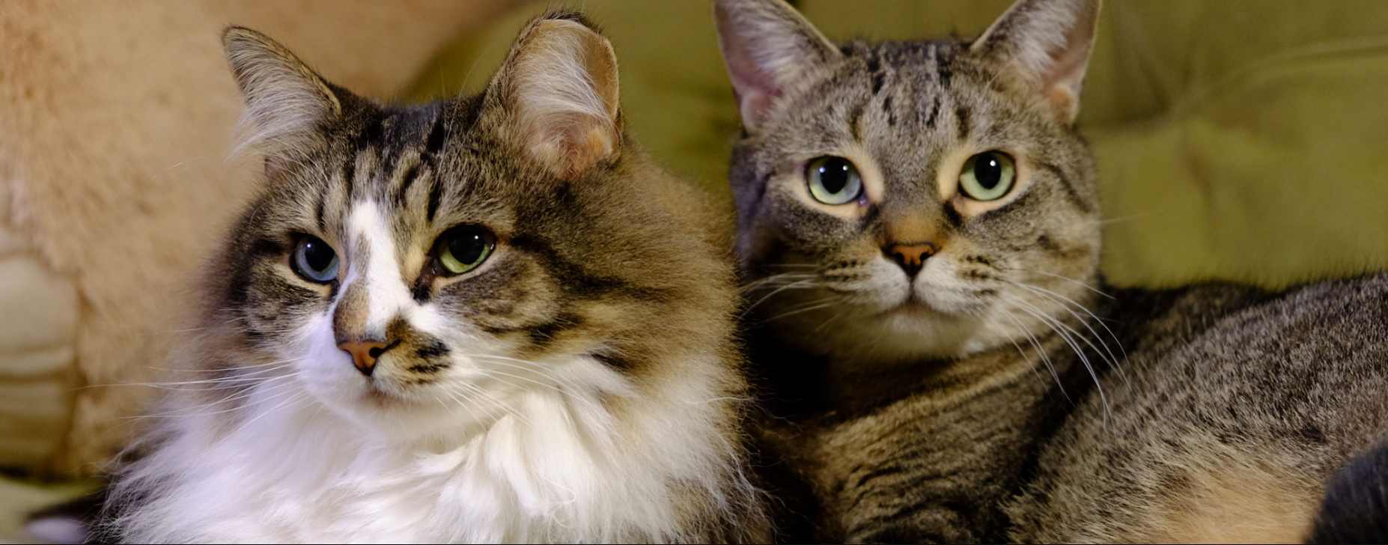
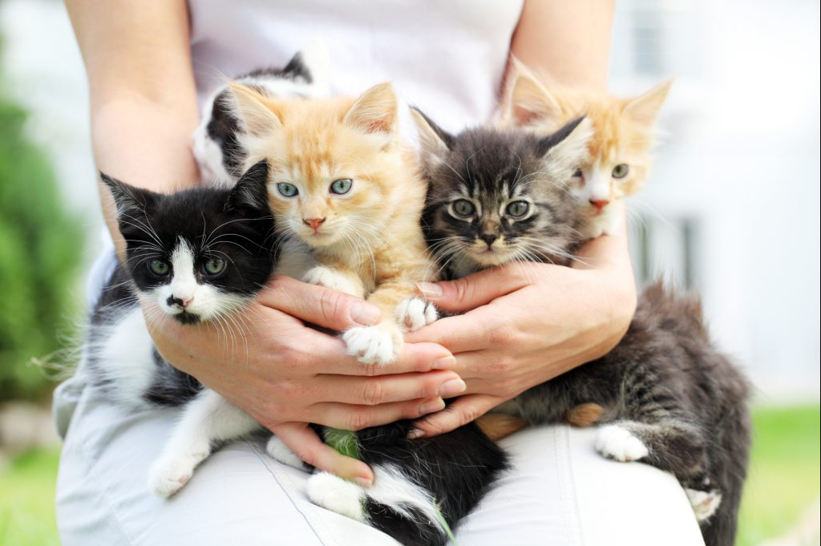
Object Detection using Convolution Neural Network
Idea 2
Sliding window + crops + Resize + Pretrained Model
Testing
Image size could be of different size. How to tackle CNN constrain?
600 x 200
300 x 250
Resize all images to same size
200 x 500
224 x 224
224 x 224
224 x 224

Slide 35
Object Detection using Convolution Neural Network
Idea 2
Sliding window + crops + Resize + Pretrained Model
Testing
Image size could be of different size. How to tackle CNN constrain?
224 x 224
MODEL
Resize
Query Input
Crops
224 x 224
Resizing the image distorts the aspect ratio of an individual object

Slide 36
Object Detection using Convolution Neural Network
convnets as FC
2352
SOFTMAX
FC1
12
x
MAX Pool
Resize
5 x 5 x 3
2 x 2
34 x 34 x 3
30 x 30 x 12
15 x 15 x 12
2352
2352
8 Class
SOFTMAX
12
x
MAX Pool
2352
x
8
x
5 x 5 x 3
2 x 2
14 x 14
1 x 1
1 x 1 x 8
28 x 28 x 12
14 x 14 x 12
1 x 1 x 2352
32 x 32 x 3
8 Class

Slide 37
Effective Receptive Field of Convolution Neural Network
FC as Convnets
4 Class
12
x
4
x
SOFTMAX
MAX Pool
3 x 3
5 x 5 x 3
2 x 2
s = 1
p = 0
10 x 10 x 3
6 x 6 x 12
3 x 3 x 12
1 x 1 x 4
1 x 1
4 Class
12
x
4
x
SOFTMAX
MAX Pool
3 x 3
5 x 5 x 3
2 x 2
s = 1
p = 0
12 x 12 x 3
8 x 8 x 12
4 x 4 x 12
2 x 2 x 4
2 x 2
Spatial Output
Effective Stride = 2

Slide 38
Effective Receptive Field of Convolution Neural Network
FC as Convnets
4 Class
12
x
4
x
SOFTMAX
MAX Pool
3 x 3
5 x 5 x 3
2 x 2
s = 1
p = 0
s = 1
p = 0
10 x 10 x 3
6 x 6 x 12
3 x 3 x 12
1 x 1 x 4
1 x 1
4 Class
12
x
4
x
SOFTMAX
MAX Pool
3 x 3
5 x 5 x 3
2 x 2
s = 1
p = 0
s = 1
p = 0
12 x 12 x 3
8 x 8 x 12
4 x 4 x 12
2 x 2 x 4
2 x 2
Spatial Output
Effective Stride = 2

Slide 39
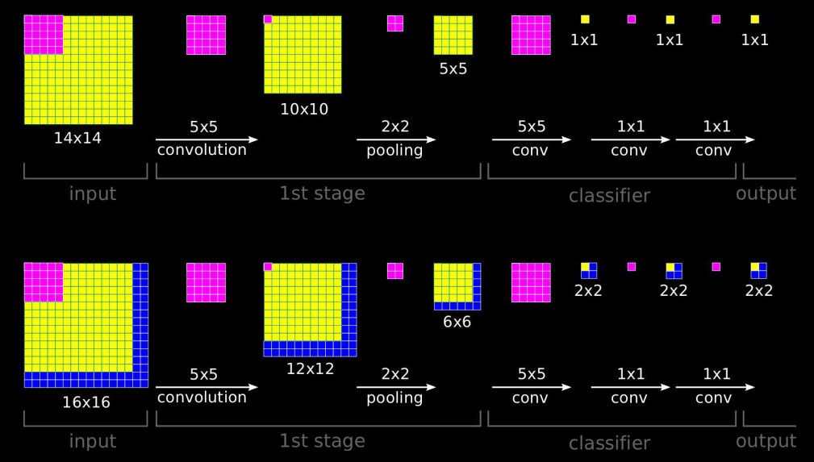
Effective Receptive Field of Convolution Neural Network
FC as Convnets
Single channel
Special Output
Effective Stride = 2
Credit: https://arxiv.org/abs/1312.6229

Slide 40
Object Detection using Convolution Neural Network
convnets as FC
2352
SOFTMAX
12
x
MAX Pool
2352
x
8
x
5 x 5 x 3
2 x 2
14 x 14
1 x 1
1 x 1 x 8
28 x 28 x 12
14 x 14 x 12
1 x 1 x 2352
32 x 32 x 3
8 Class
2352
SOFTMAX
12
x
MAX Pool
2352
x
8
x
5 x 5 x 3
2 x 2
14 x 14
1 x 1
2 x 2 x 2352
2 x 2 x 8
34 x 34 x 3
30 x 30 x 12
15 x 15 x 12
8 Class

Slide 41
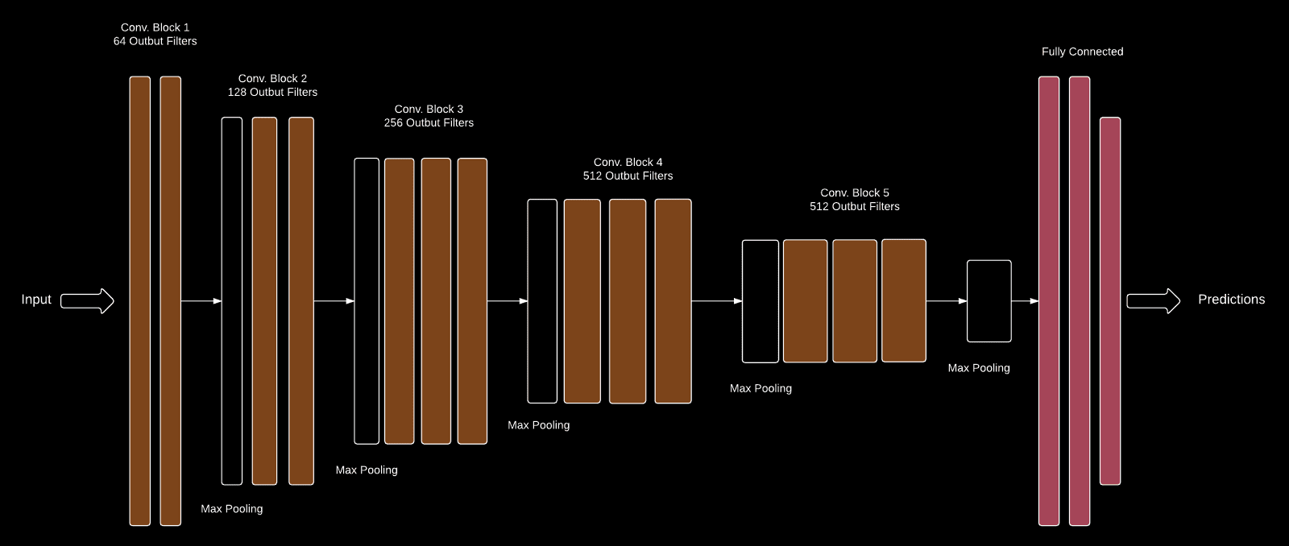
Object Detection using Convolution Neural Network
VGG 16
SOFTMAX
1000 Class
7 x 7 x 512
4096
4096
1000

Slide 42
Object Detection using Convolution Neural Network
VGG 16
convnets as FC
SOFTMAX
1000 Class
7 x 7 x 512
1 x 1 x 4096
1 x 1 x 4096
1 x 1 x 1000

Slide 43
Object Detection using Convolution Neural Network
Idea 3
Sliding window + Crops + Pretrained Model
Testing
FC1
Regression
MODEL
FC2
VGG 16
Feature Extraction
Classification
Query Input
Crops
Pre Trained Localize Model
Image size could be of different size. How to tackle CNN constrain?
we still have problem of feeding one crop at a time to model.
Is there any way to make it End to End ?

Slide 44
Object Detection using Convolution Neural Network
Idea 3
Sliding window (spatial output ) + Pretrained Model + FC as convnet
Testing
FC1
Regression
MODEL
FC2
VGG 16
Feature Extraction
Classification
Query Input
Pre Trained Localize Model
Image size could be of different size. How to tackle CNN constrain?
Use FC as Convnet

Slide 45
Difference between Sliding Window as Crops v/s Special Output
Sliding Window as Crops
Special Output
MODEL
MODEL
Query Input
Query Input
Crops
Processing each crop one by one
Computationally very Costly.
End to End
CNN share the computational memory therefore, much faster to process.

Slide 46
Object Detection using Convolution Neural Network
Idea 4
Sliding window (spatial output ) + Pretrained Model + FC as convnet + Image Pyramid
Testing
How to detect multiple size image?
Image size could be of different size. How to tackle CNN constrain?
we still have problem of feeding one crop at a time to model.
Is there any way to make it End to End ?
Sliding window (Special output )

Slide 47
Object Detection using Convolution Neural Network
Idea 4
Sliding window (spatial output ) + Pretrained Model + Image Pyramid
Testing
How to detect multiple size image?
FC1
Regression
MODEL
FC2
VGG 16
Sliding window
+
Image Pyramid
Feature Extraction
Classification
Pre Trained Localize Model
Constrain of CNN

Slide 48
Object Detection using Convolution Neural Network
Idea 4
Sliding window (spatial output ) + Pretrained Model + Image Pyramid + FC as convnet
Testing
How to detect multiple size image?
FC1
Regression
MODEL
FC2
VGG 16
Sliding window
+
Image Pyramid
Feature Extraction
Classification
Pre Trained Localize Model

Slide 49
Spatial Outputs of Image Pyramids
Special Output
Effective Stride = 2

Slide 50
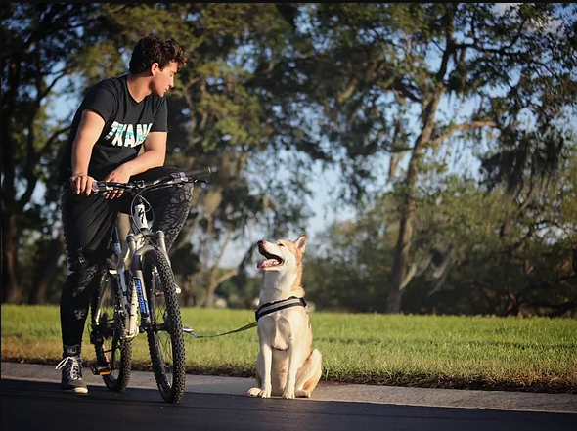
260 x 296
248 x 272
236 x 248
224 x 224
Smaller objects
Larger objects
Large scale image
Small scale image

Slide 51
Object Detection using Convolution Neural Network
EXAMPLES
Sliding window (spatial output) + Pretrained Model + Image Pyramid + FC as Convnet
Testing
Sliding window + Image Pyramid
Pretrained Localize Model
NMS
Query Input
Predicted Output

